Slide 1
5 selfish reasons to work reproducibly
More publications, more grants, more awesome!

Slide 2
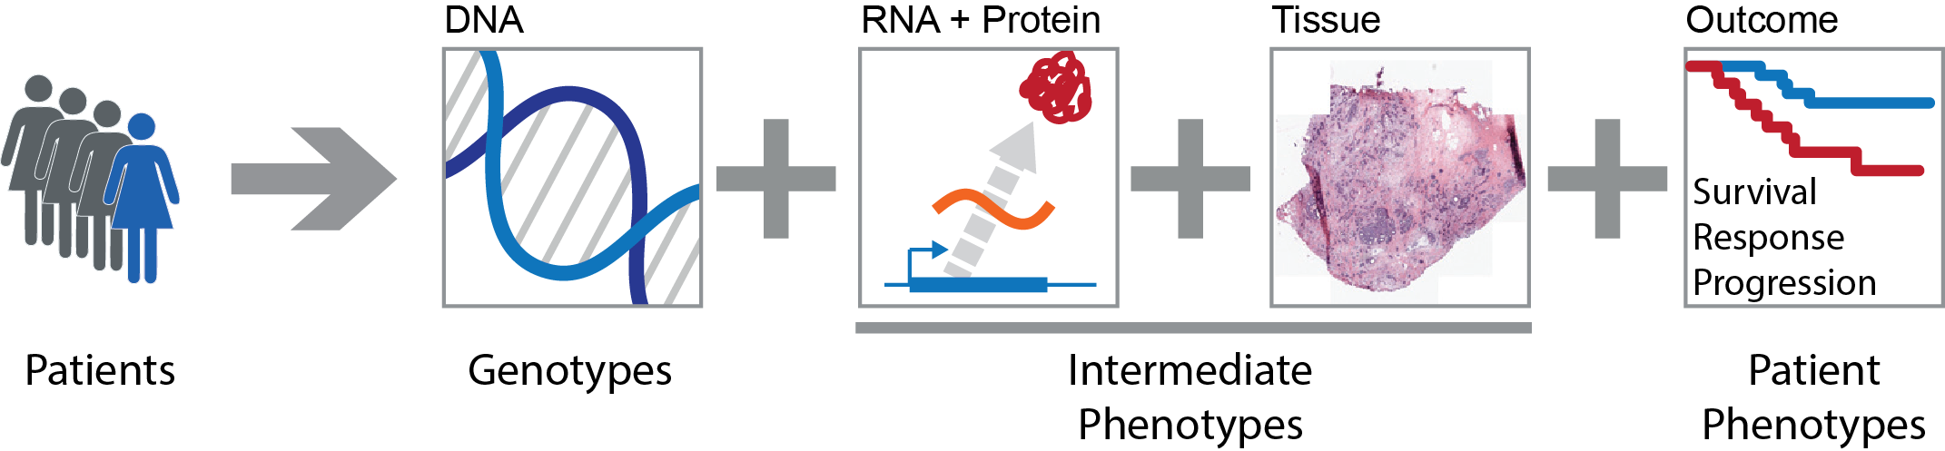
Systems Genetics of Cancer
Genetic variation
In people
In tumours
In clones
Phenotypic variation
Tumour subtypes
Aggressiveness
Survival

Slide 3
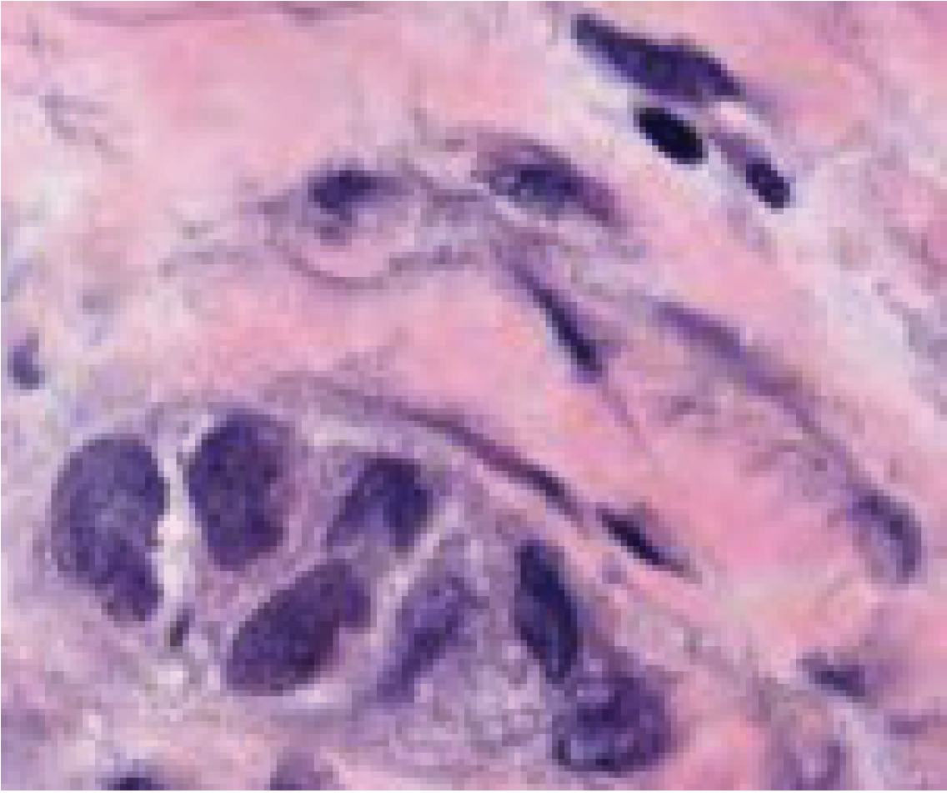
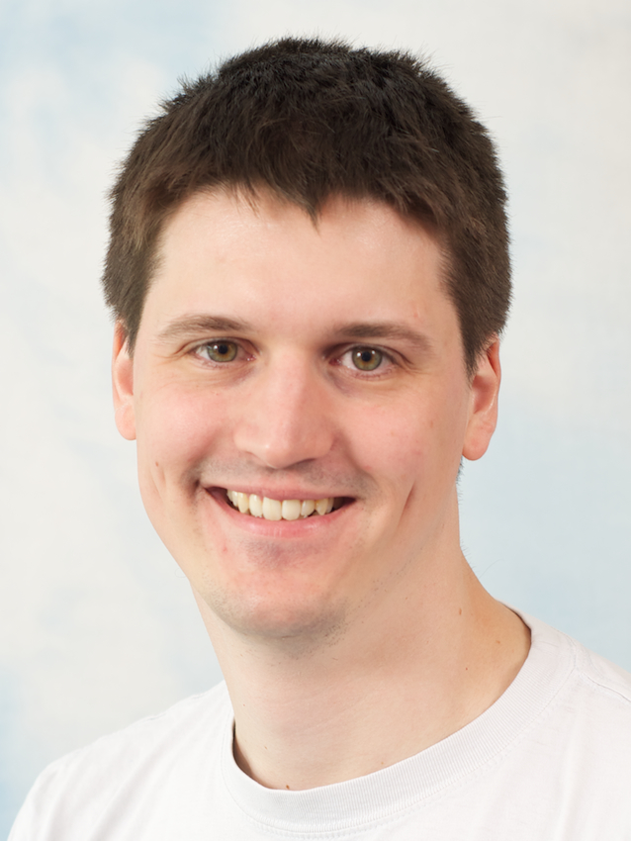
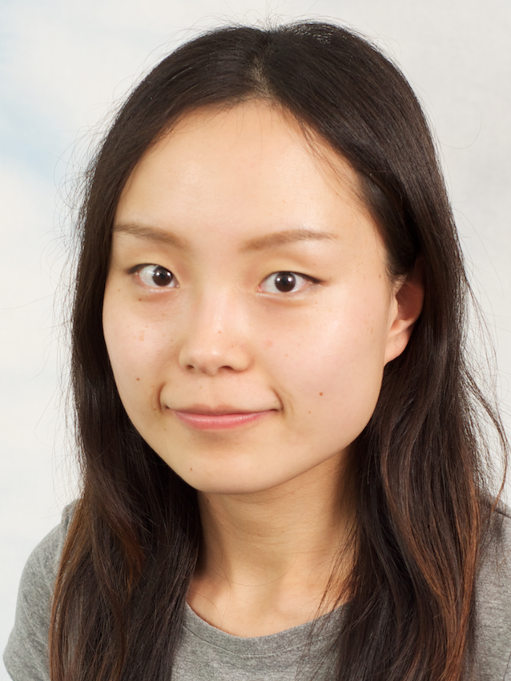
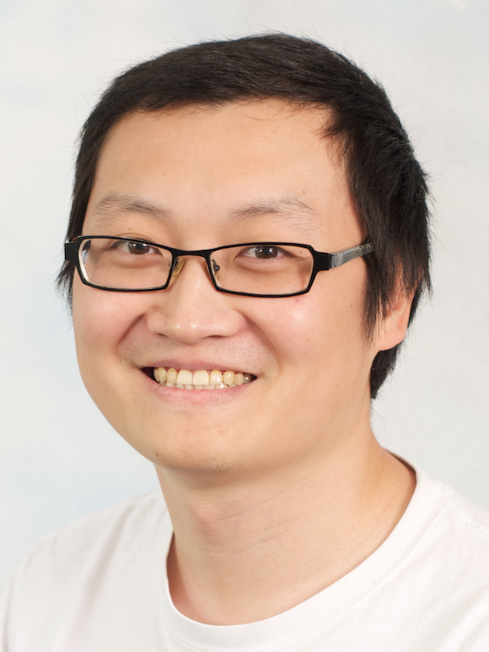
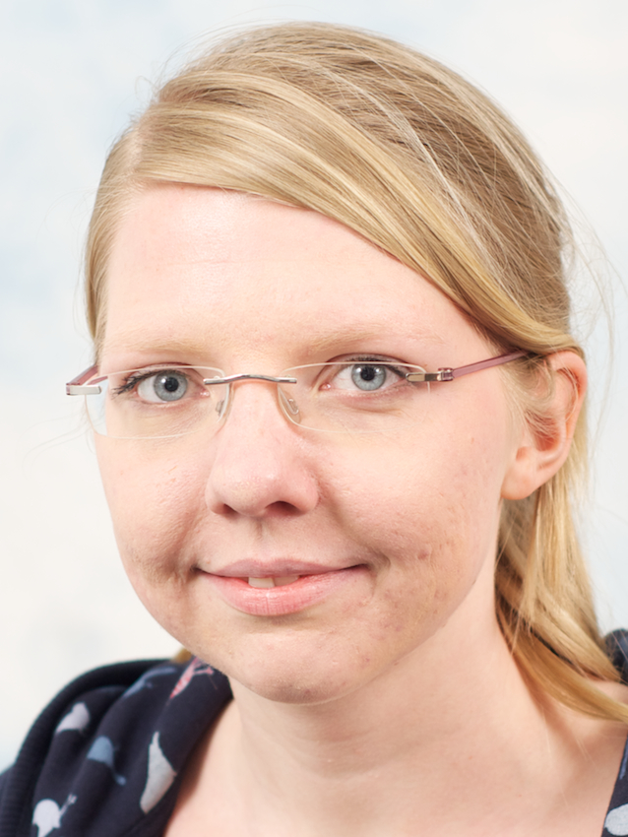
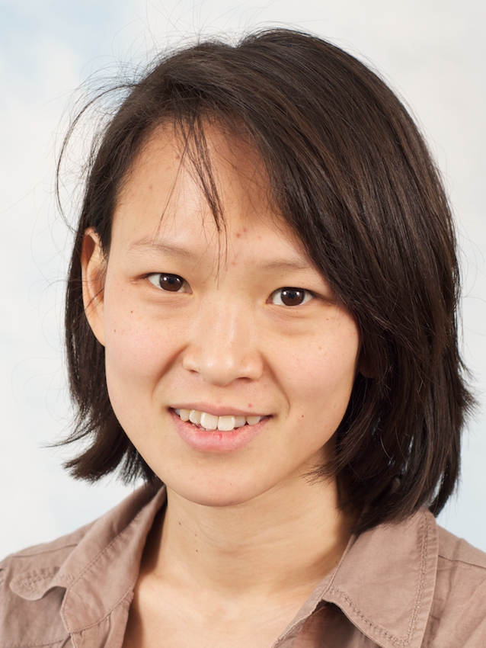

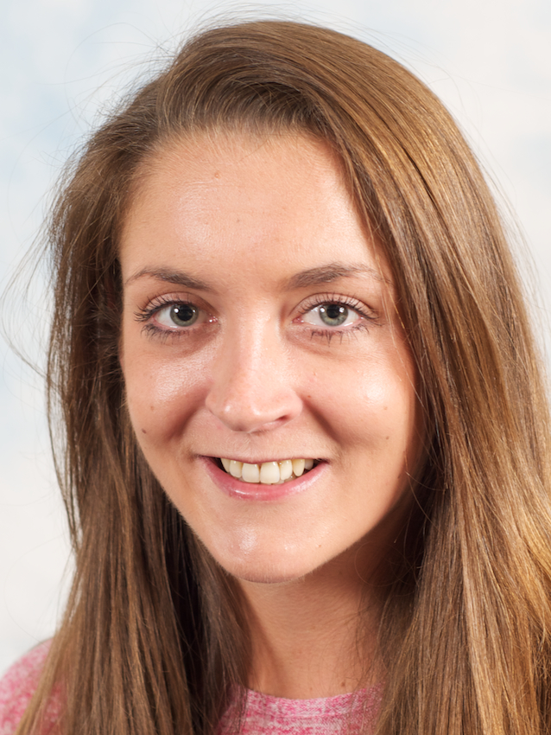
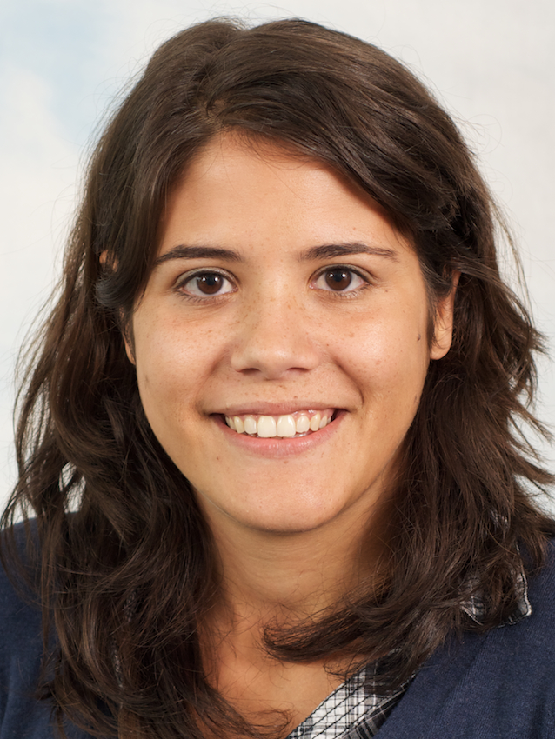
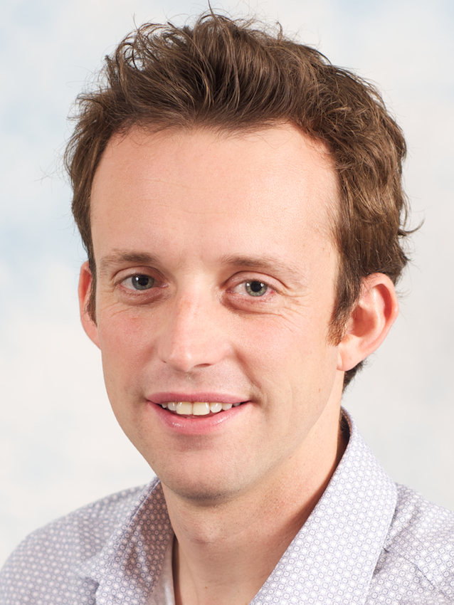

Cancer genome
Function
Cancer genome
Evolution
Cancer tissue
Context
Andy
Wei
Ke
Edith
Anne
Joe
Amanda
Ines
Geoff
Leon

Slide 4
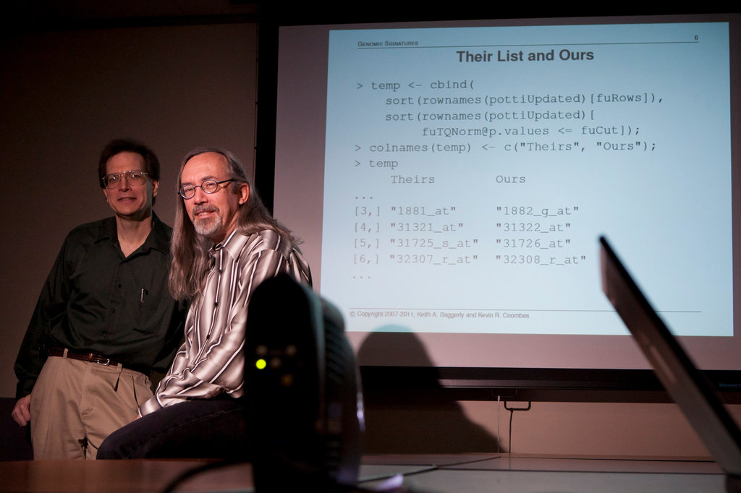
“How Bright Promise in Cancer Testing Fell Apart” New York Times, July 7, 2011

Slide 5
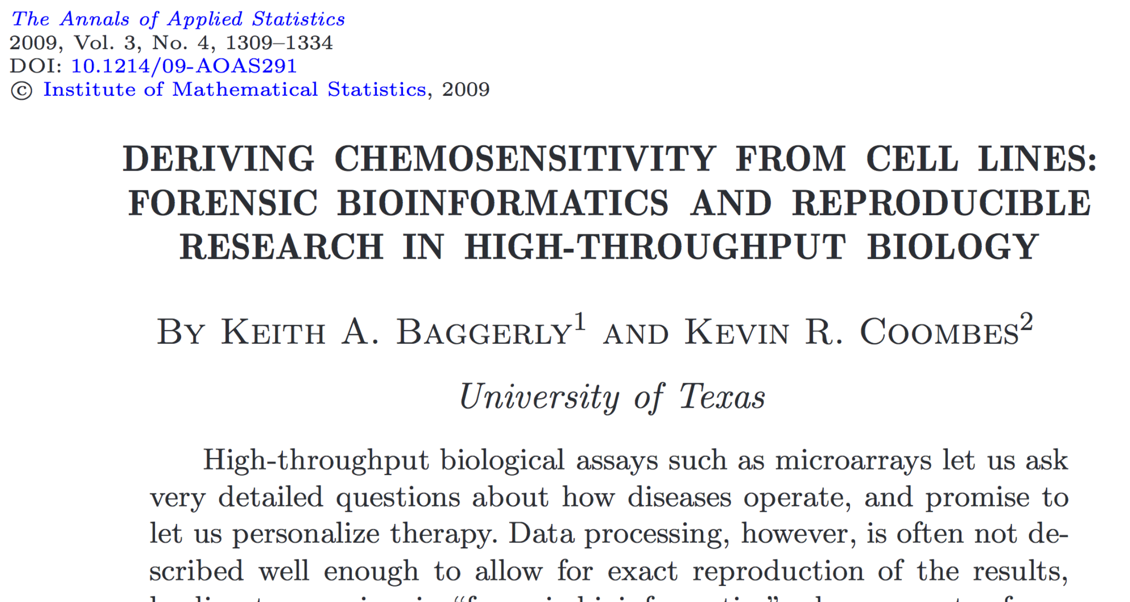

Slide 6
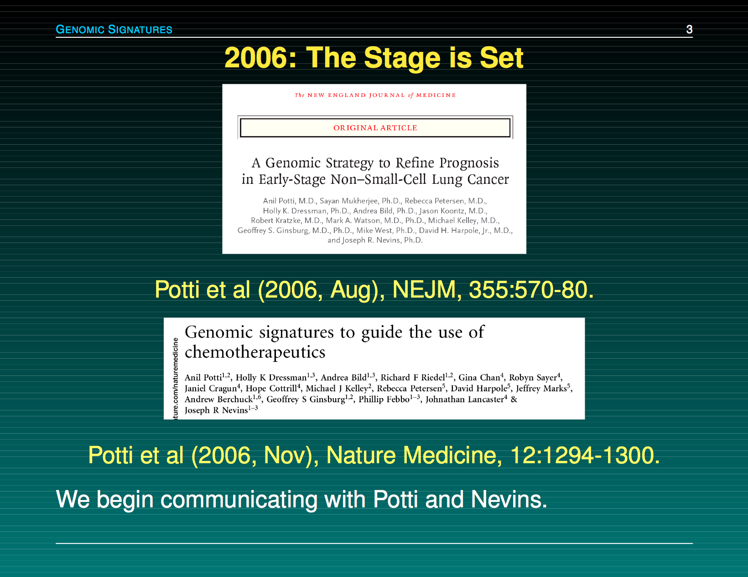

Slide 7
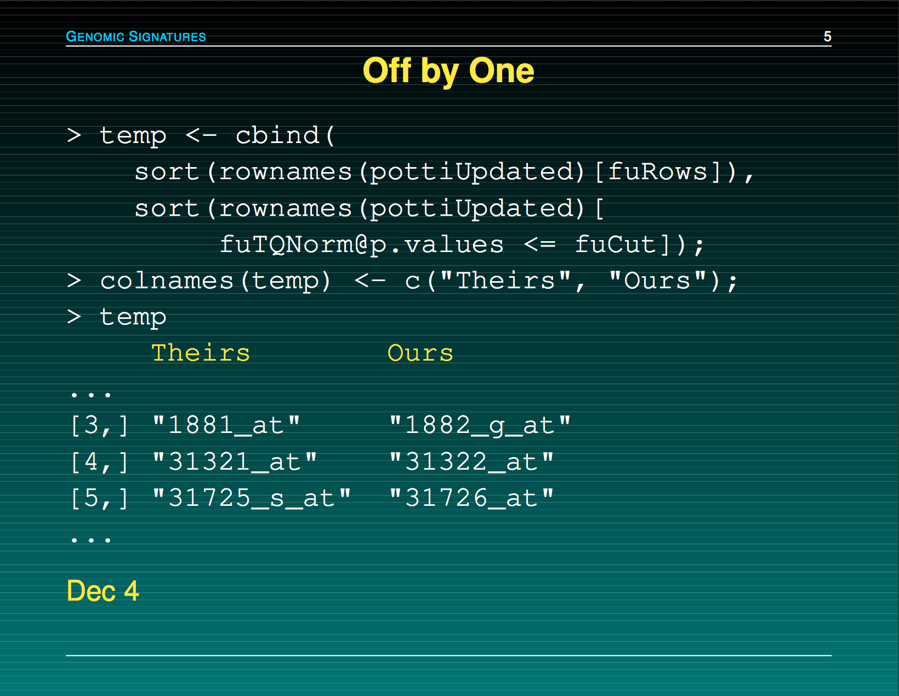

Slide 8
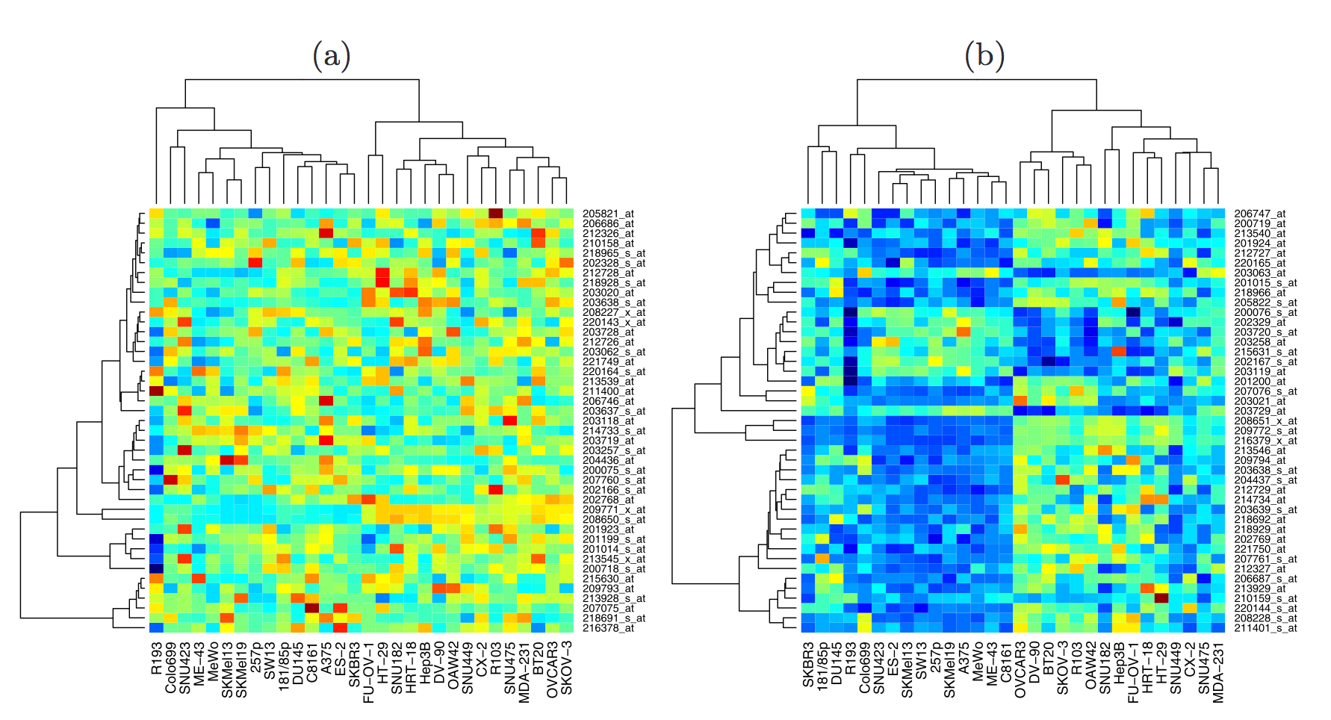
Baggerly & Coombes, AOAS 2009

Slide 9
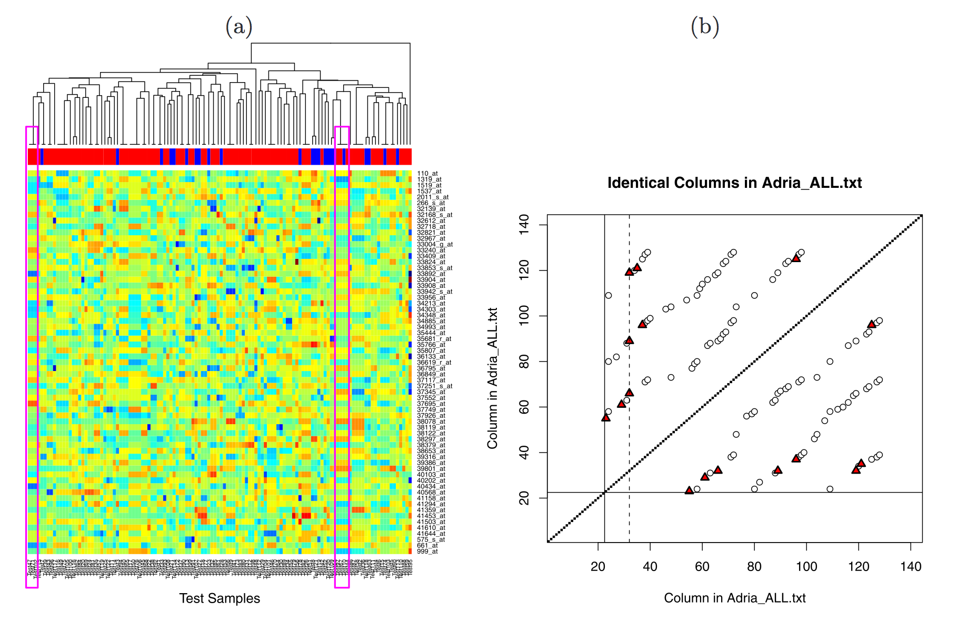
Baggerly & Coombes, AOAS 2009

Slide 10
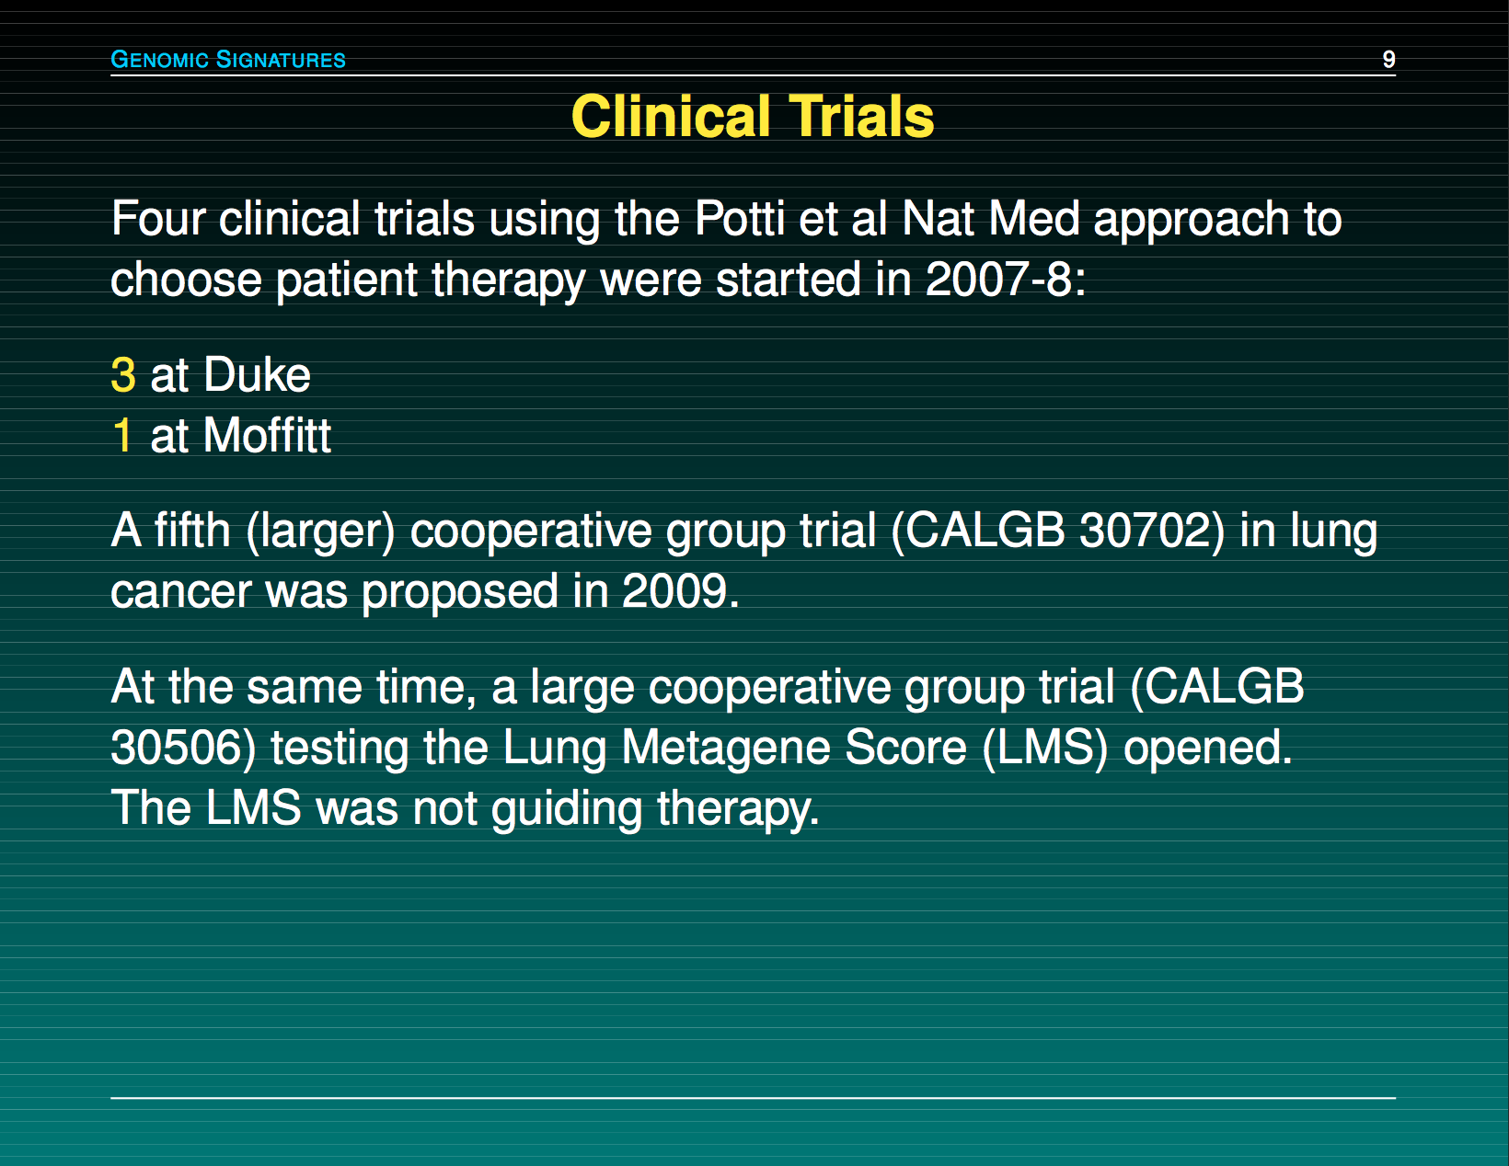

Slide 11
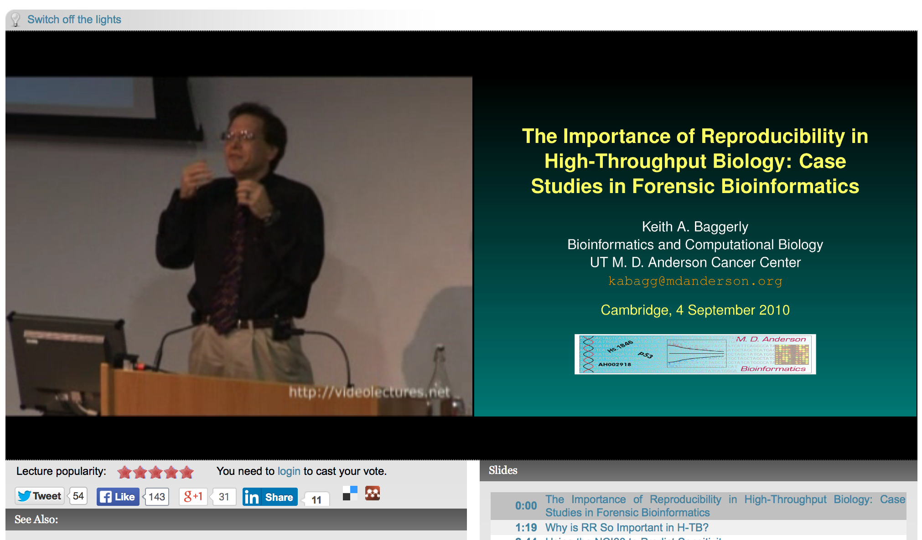
http://videolectures.net/cancerbioinformatics2010_baggerly_irrh/

Slide 12
Reproducibility
0
It’s the right thing to do!
The world would be a better place if everyone did it!
It’s the foundation of Science!
It’s the honourable thing to do!

Slide 13


Slide 14


Slide 15
Avoid disaster
1

Slide 16
Anatomy of the NFκB pathway
Step 1
?
Hits
Weak
Phenotype
Strong
NFκB
Step 2
Knock-down
Compare
expression
phenotypes
by NEMs
Known pathway
members
New RNAi Hits

Slide 17
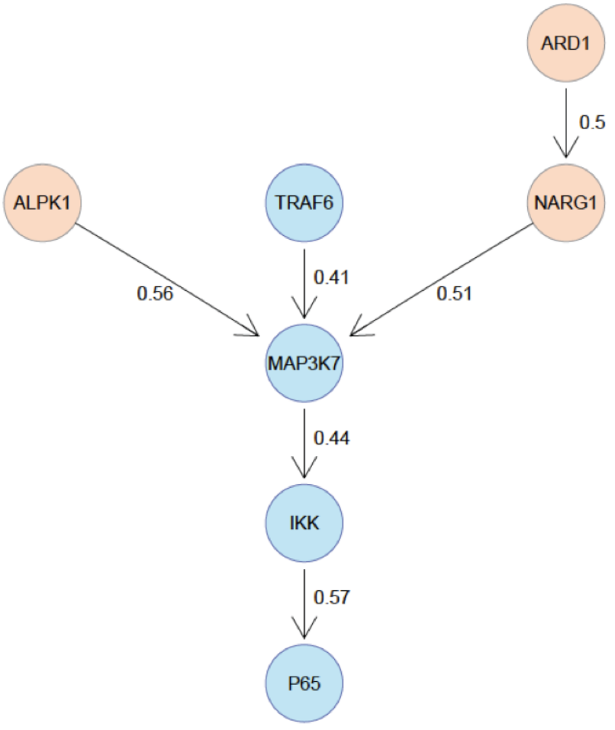
What a nice result!

Slide 18
Makes it easier to engage
2

Slide 19
Example: grade

Slide 20
It enables continuity in the lab
3

Slide 21
Going back to your own code can be really tough, even tougher when continuing on others projects

Slide 22
Easier to argue with reviewers
4

Slide 23
PLoS Medicine example

Slide 24
It increases your standing in the community
5

Slide 26
5 selfish reasons to work reproducibly
Avoid disaster
Makes it easier to engage
Continuity in the lab
Easier to argue with reviewers
Standing in the community

Slide 27
Excuses people make
You should do it, but the effort you put into should be valued by the group you work in and your supervisor.
It takes too long
It should be every postdocs business how to document their work
I can do all this in Excel

Slide 28
When do you need to worry about reproducibility?
Before you start the project
When you do the analysis
When you write the paper
When you co-author a paper
When you review a paper
ALWAYS!

Slide 29
The next two talks
Gordon Brown
Stephen Eglen

Slide 30
If you have a new algorithm or method, mot people make their code available
BUT what I talk about are analysis scripts using ‘standard’ software.

Slide 31
Reproducibility rulez!
Thank you !

